Slide 1
MMIX Models For Long-Term Effects
Dr. Ceren Kolsarici

Slide 2
Performance Measurement Comes First
Marketing, too often, is perceived as a "cost" to the company than an "investment".
Where does marketing belong? P&L vs. Balance Sheet
Marketing budgets are the first in line when it comes to budget cuts and last when it comes to source of long-term growth.
Bizarre? Yes! Who to blame?
Marketers are, and should be, accountable for their decisions.
A & AI are great tools we have measuring marketing performance; justifying and revising strategic and tactical plans.
In justifying the advertising budget, quantifying the long-term effects is critical

Slide 3
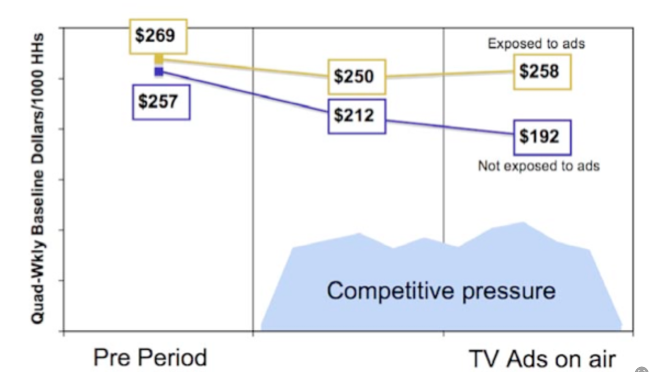
Advertising Works by Creating and Refreshing Memories
Advertising-sales relationship is difficult to observe because:
Most advertising aims to maintain market share (i.e., opportunity cost of not spending) → Sales is the height the plane flies, advertising is the engine
Advertising’s sales effects are spread out in time → The effect of today's advertising is layered very thinly across weekly sales figures over a long time period. It typically takes dramatic bursts of expenditure to cause a week's figures to detectably increase.
Typical MMIX models only show a weak effect size for advertising-sales relationship
Causal models or single source individual-level data show greater advertising effects
Bryan Sharp, How Brands Grow

Slide 4
Advertising Works by Reaching Brains and Nudging Buying Propensities
Two hurdles in front of effective advertising
An ad cannot build memory structures if it’s not processed
Memory structures cannot generate sales if they are not associated with the brand being advertised
Advertising must work through memories to influence consumer behavior
Refresh, and occasionally build, memory structures, which are noticed and/or recalled in buying instances, and increases purchase propensity
Some advertising aims to persuade (i.e., create intention to buy)
Much smaller percentage compared to memory structures
Advertising achieves
Signaling (i.e., attributing brand characteristics to people)
Priming (e.g., college students returning to campus after Halloween rated orange brands more favourably)
Only 20% of ads are noticed and correctly branded → 80% wastage

Slide 5
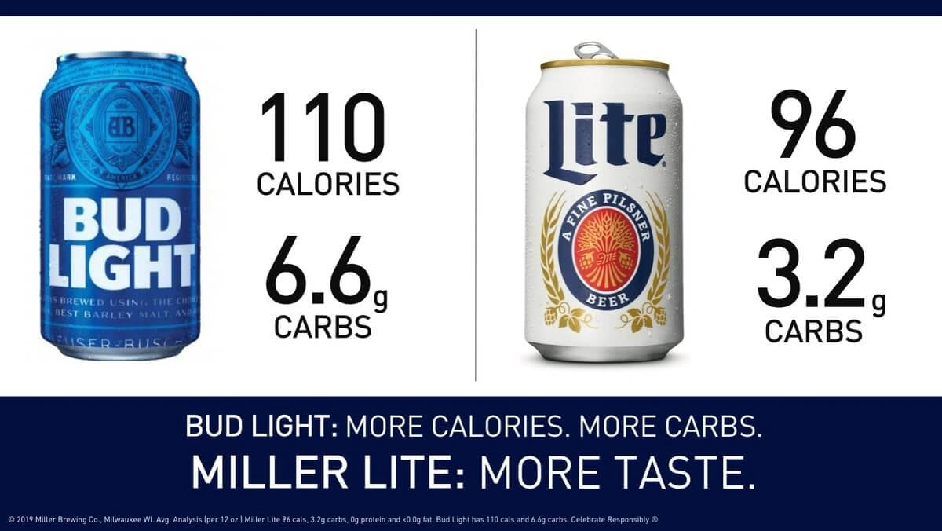

Slide 6


Slide 7
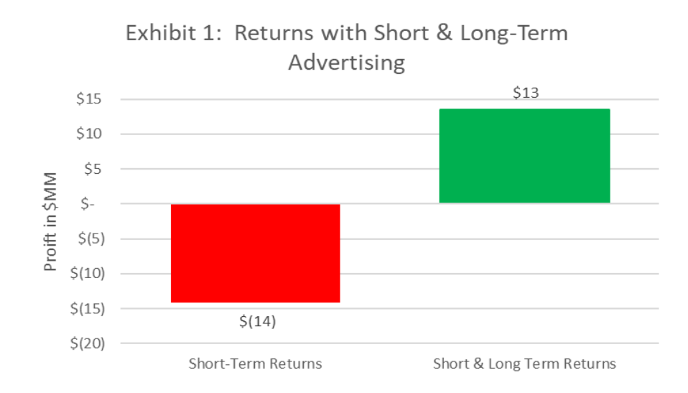
Sales Impact of Advertising
The Short-term effect:
This involves customer acquisition or sales which would not occur without advertising. These sales mainly occur within 3-8 weeks from when the ad exposure occurs (varies across product categories).
The Long-term effect.
This involves sales after the first-time sale from a person who continues to buy the brand over its lifetime. This involves retention marketing and occurs in a compound-interest-like fashion across long periods of time.
Analysis Across 26 brands (Michael Wolfe, 2023)

Slide 8
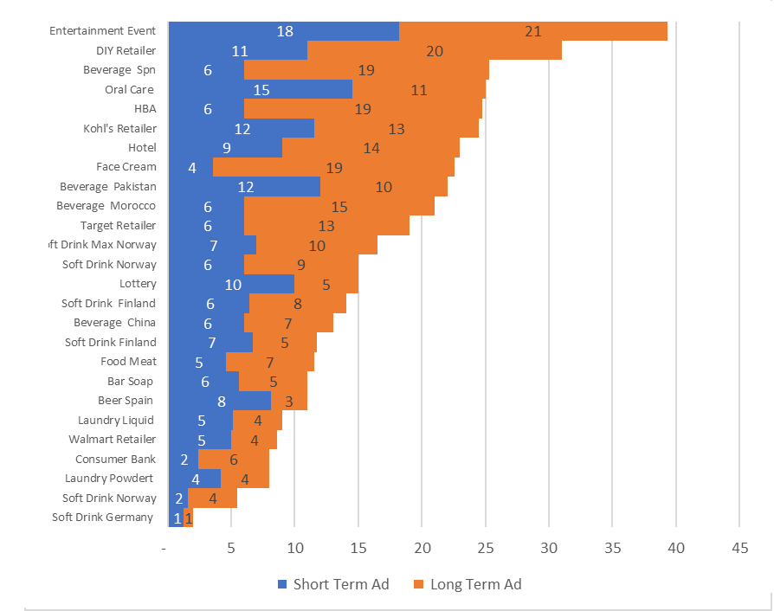
Long- and Short-Term Advertising Impact
Brands with high “long term advertising” tended to be large-sales brands with strong brand loyalty and high market shares.
Coca-Cola Mexico (50% MS)
Nivea Face Cream (95% repeat buyer rate)
Harlem Globetrotters
Coca Cola Mexico
Nivea Face Cream
Brands with smaller long-term ad effects tend to be more “impulse-driven purchases” and more commodity-like, with weak branding.
Analysis Across 26 brands (Michael Wolfe, 2023)

Slide 9
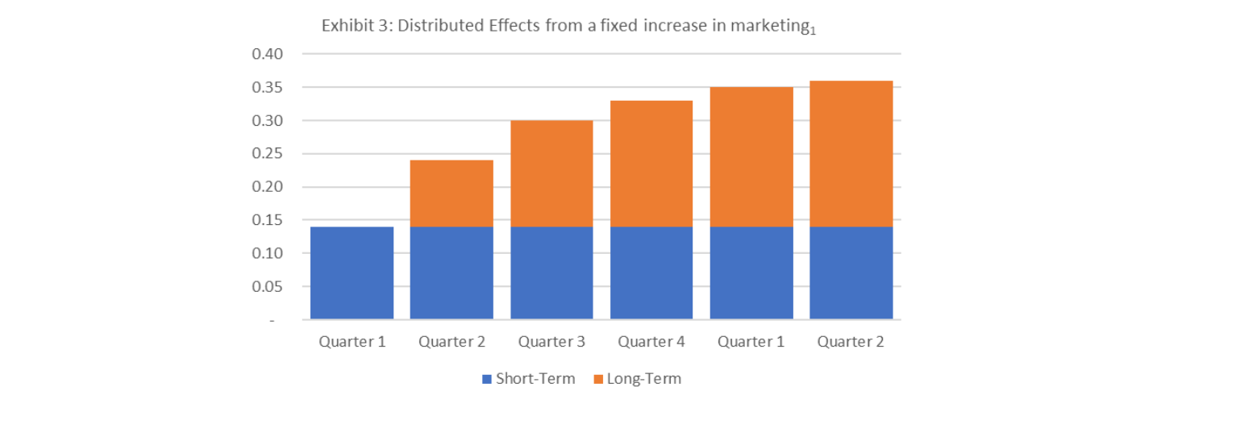


Distributed Effects from a Fixed Increase in Ad Spend
A distributed lag econometric model shows how a fixed increase in advertising typically spreads over time.
Even a small increase can still affect a brand over more than a year.
Long-term effect of advertising is 1.6X the short-term sales lift.
$${ROI}_{LT}≥5 x ROI_{ST}$$
Nariman K. Dhalla, Harvard Business Review, Assessing the long-Term Value of Advertising, Jan. 1978

Slide 10
Incorporating LT Ad Effects in MMIX Models
Advertising’s long-term impact on sales could be due to:
Delayed ad effect: consumers take a while to act on the ad
Customer holdover: consumers act on the ad, and repeat purchase
Distribution: retailers may react to ads by giving the brand better shelf space
The delayed ad effect is typically tied to the purchase cycle, e.g, customers may not be currently in the market for the product, or consumers have to wait for a doctor's visit to ask for the advertised prescription medicine. In such situations, ads can build memory structures and/or keep the brand top of mind when the purchase occasion arises.

Slide 11
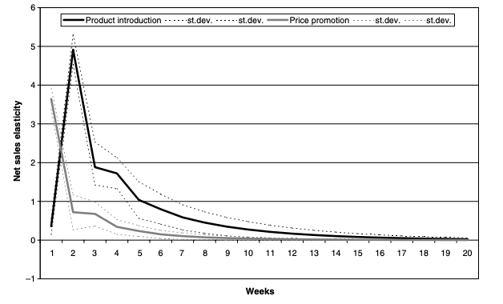
Net Sales Elasticity for Advertising v. Price Promotions
In this first (dark line) scenario, the peak impact of advertising is only reached after a few periods (wearin), after which the impact declines (wearout) until indistinguishable from zero (return to baseline sales).
Pauwels et al. (2004), Long-Term Marketing Effectiveness, Marketing Science

Slide 12
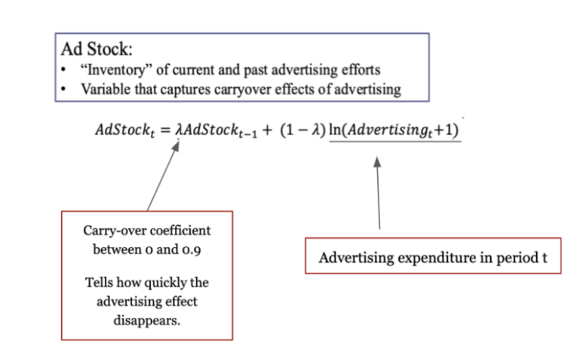
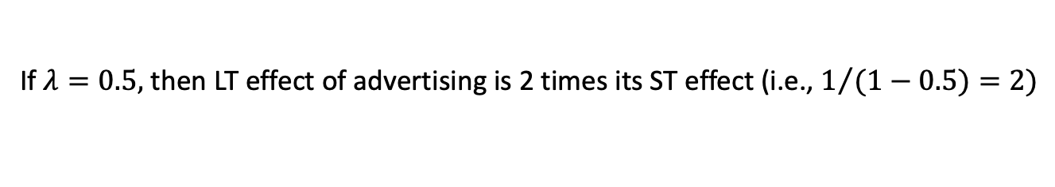
Ad Stock Model to Capture Dynamic Effects
If $λ=0.5,$ then LT effect of advertising is 2 times its ST effect (i.e., $1/{(1−0.5)}=2)$

Slide 13
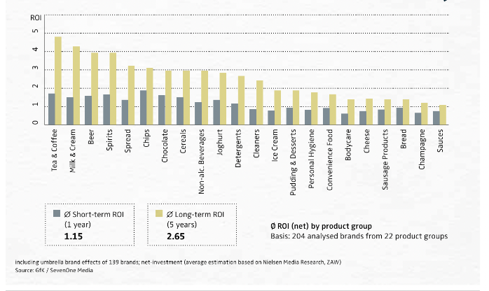
ROI of TV Advertising Across Categories
Analysis of 204 German TV ads, Wildner and Rodenbach (2015)

Slide 14
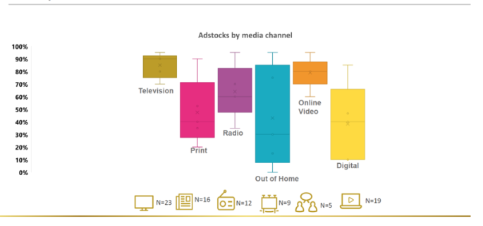
Decay Rates Differ by Campaign, Brand, Channels
TV ads tend to have a slower decay rate, with recall retention at 0.7-0.9.
Digital (display) usually has the greatest decay rate, retaining weekly recall at a 0.1-.06 rate.
All rates presumably depend on more granular factors such as the length of the video, the context of the placement, etc.
Zaldivar (2023)

